Slide 2
Dragonfly Introduction
Allen Sun, alibaba
Zuozheng Hu, alibaba

Slide 3

Status
Roadmap
01
03
Agenda
02
04
History
Adoption

Slide 4
PART ONE
History
01

Slide 5
What and Why
P2P based, high reliable, image distribution
system at large scale
Bottleneck in pulling images in DCs of
Alibaba Group

Slide 6
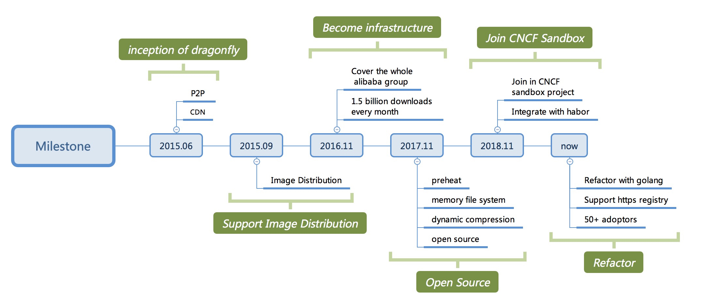
Milestone

Slide 7
PART TWO
Status
02
Notes:
1 Hello, everyone. I am the founder of dragonfly, leading its design and part of the development. Now, let me introduce the dragonfly’s current situation
2 Dragonfly has been opened source for 18 months and has joined the CNCF Sandbox project
3 Since dragonfly is a image distribution system，there is no doubt that distribution efficiency is its first element. So let's start with a performance comparison

Slide 8
Native vs Dragonfly
Testing conditions:
Server: 2 VMs(24C64G, SSD,
1000Mb/s)
Client: 200 VMs(4C8G, 100Mb/s)
Conclusion:
Dragonfly is more smoothly than native
With the expansion of the scale, dragonfly’s advantage becomes more and more obvious
Notes:
1 On the left is the testing condition，There are two virtual machines running server and 200 virtual machines as clients
2 On the right is the performance comparison data，X-axis is the number of parallel downloads, and Y-axis is the average download time，The orange curve represents the average time using dragonfly to download image. It can be clearly seen that with the expansion of download scale, download time is still very stable, basically maintained at about 80 seconds. After calculation, the download makes full use of the client's network bandwidth, about 90% bandwidth. It also shows that dragonfly's P2P effect is very remarkable. In contrast , let’s see the green curve, it indicates the download time with the native mode, which downloads images directly from registry. It is obvious that download time increases exponentially as the scale increases. At the same time, when the scale reaches a higher level, the registry will go down. which leads to the failure of download, but using dragonfly doesn't have this problem. Because only the super node downloads image just once from registry to make the initial seed for the client to use. It can also provide CDN cache for subsequent downloads.
3 From the above data, we have good reason to believe that dragonfly can solve the problems about efficiency and stability at large scale image distribution. At the same time, the use of dragonfly will not bring any intrusive modification to the container engine、image registry、 kubernetes and so on. Of course, dragonfly also supports integration with related systems in order to generate more "chemical reaction" and further enhance its distribution capability.
4 Okay, just now we've learned that dragonfly has a very powerful capability to distribute image. So what is the status of dragonfly in the open source community?

Slide 9
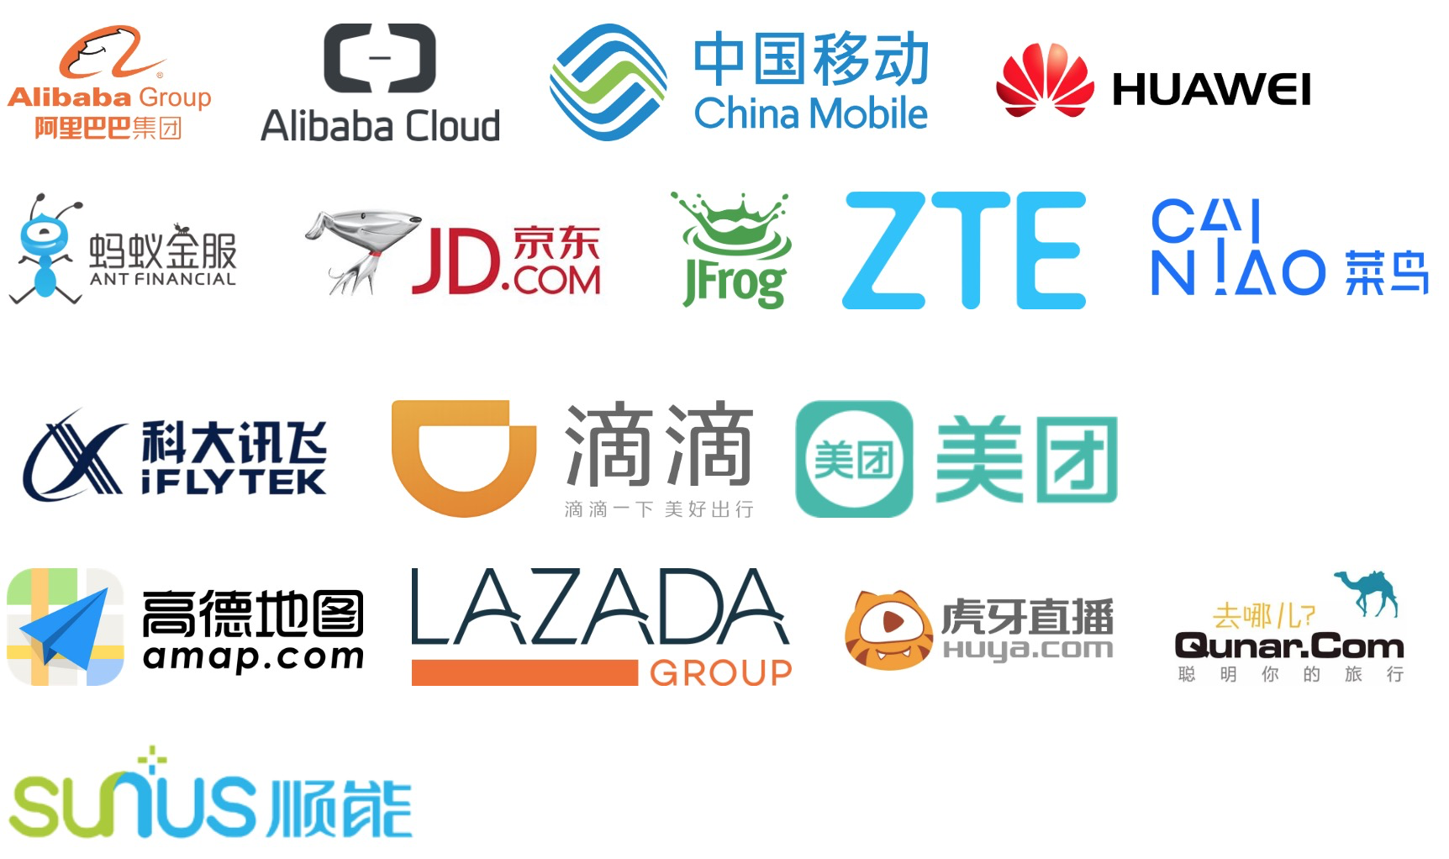
Community Situation
Stars: 3400+
Adoptors: 50+
Maintainers: 6
Outside: 1 ebay, 1 meitu
Internal: 4 alibaba group
Contributors: 32
Discussion Group:
DingTalk: 23304666
Gitter: please refer to Github
Notes:
1 At present, more than 50 companies have become adopters of dragonfly, which are distributed in various industries. including Alibaba Cloud、Ant financial, China Mobile、HuaWei 、lazada and so on
2 Dragonfly currently have more than 3400 Stars on Github, as well as six maintainers and 32 contributors.
3 In addition to Github, we also have a variety of community discussion groups, such as Gitter, DingTalk and WeChat.
4 Dragonfly is about to complete its refactor with Golang and is designing many new features. We warmly welcome interested people to join us to make dragonfly stronger and stronger.
5 We have just introduced the current situation of dragonfly’development in the community. Next, let's focus on the main principles and core architecture of dragonfly. I believe you will be more interested in this aspect.

Slide 10
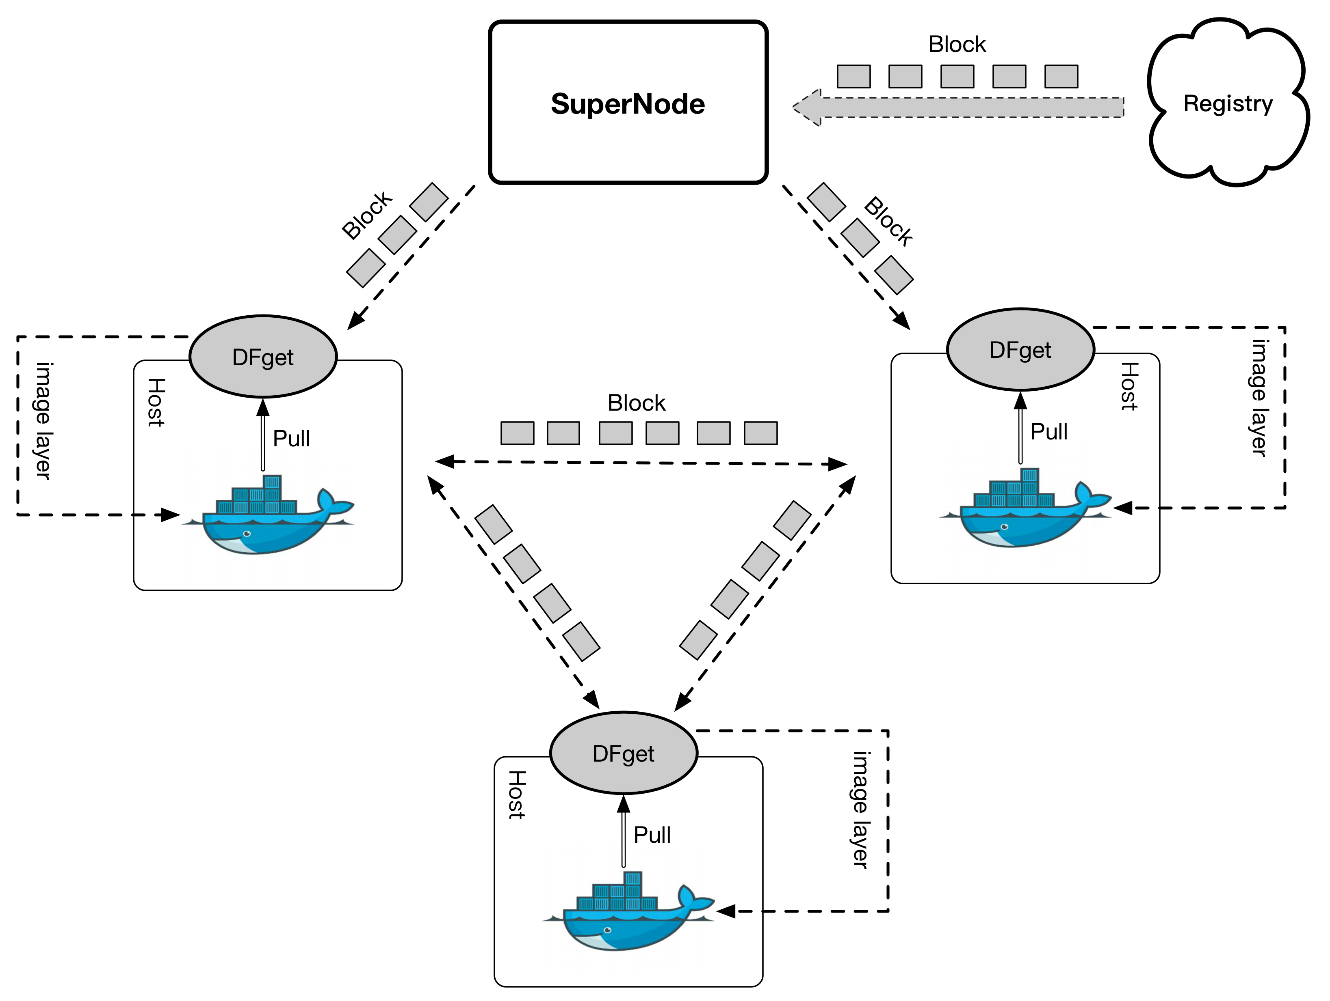
P2P Mechanism
Notes:
1 First, let's briefly analyze the process of image distribution with dragonfly’s P2P technology.
2 Dragonfly client named dfget is installed on each Node, which is configured as a download proxy for the container engine
3 When the container engine executes the PULL Image command, the request request will enter the proxy. so the dragonfly client will get the download url of a image layer from the registry, and then accesses the super node with some parameters including that url and other data.
4 When the super node receives the registration request from the client, it will add the client to a P2P network, which is composed of multiple clients downloading the same image layer.
5 At the same time, the super node will synchronize the image from registry at most once. In the process of synchronization, every block downloaded will generate a seed in the local storage, which can be immediately spread between multiple clients.
6 When the client finishes all the pieces of a layer, the container engine will copy the layer from the client to the local image store via local http request. We are also planning to further accelerate the download by streaming mode ，which can avoid disk IO and copying on the client side.
7 each layer’s download is as shown above, and when all the layers needed for a image are downloaded, then the Pull command is executed successfully.
8 If there are other nodes that will need to download the same image afterwards, because the previous one has been cached by CDN, the seed in caches can be directly used for block propagation, without synchronizing the image from registry and making the seed again. obviously, the download rate will be faster than the previous one.
9 Okay, I believe everyone already knows more about dragonfly. Finally, I'd like to introduce the core architecture of dragonfly, which is super node’s architecture

Slide 11
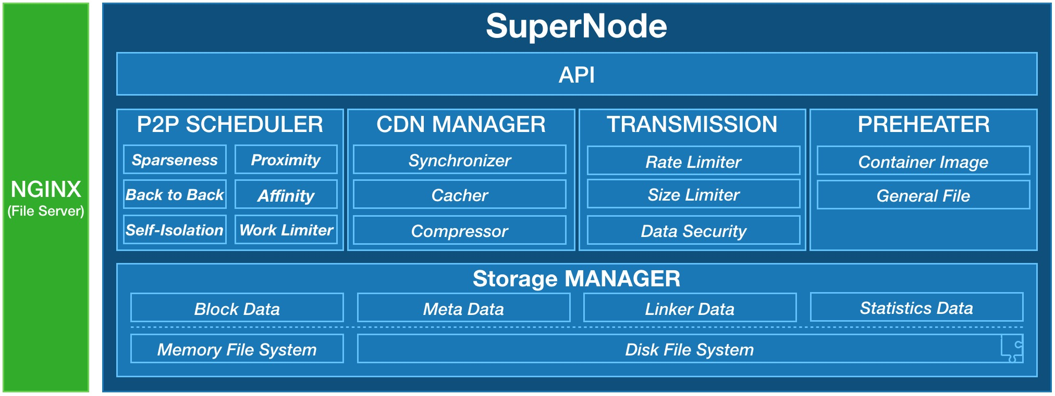
SuperNode ARC
Dragonfly dose
its best to speed up download
and save traffic!
Notes:
1 By introducing the super node architecture, you will understand how dragonfly do its best to improve the download rate and save network traffic.
2 Super node is mainly composed of five modules, including P2P scheduler, CDN management, transmission controller, data preheater and storage management.
3 The P2P scheduler is responsible for assigning download tasks to each client. The task information mainly includes block number and which client the corresponding blocks will download from. There are a total of six scheduling strategies. I‘ll introduce the first three strategies. First, Sparseness denotes preference for choosing blocks that are least distributed in the p2p network, by this way, each block can be evenly distributed in the P2P network, which can avoid the occurrence of “scarce resource”. The second strategy is Proximity，which means that the client prefers to download blocks from the nearest nodes, which greatly reduces network latency. The third strategy is Back to Back, which indicates preference for choosing some blocks, which are not yet downloaded and are closest to the last blocks that were downloaded by the current client. After that, the client will write disk in approximately sequential order to improve I/O efficiency. ok，The first three strategies have been introduced, and the others will not be introduced one by one.
4 Next, let's focus on CDN management. which has three main functions，synchronizer is responsible for downloading image from registry and generating block seeds，it also controls that the same image will only be downloaded once. Cacher is responsible for verifying the validity and consistency of caches, In addition, Cacher is also used to process cache GC. Compressor is responsible for choosing the most compressible blocks for compression, By this way, we can obtain very high compression revenue, which can not only increase the speed, but also save network traffic to a large extent.
5 okay，let's look at another module. it is transmission controller, which is mainly used to control the upper limit of download rate and block size，At the same time, each block has been encapsulated by super node, which can ensure the integrity of block and avoid tampering with it.
6 Next, let’s focus on preheater, which refers to automatically synchronize the required image to super node before download, so it can eliminate the synchronization from registry in the download process.
7 The last is storage management ，which is mainly responsible for the storage of various data, including block data, seed metadata, soft linker and statistics for distribution and so on. In addition, super node can also determine whether to use memory file system according to the hardware, If the memory file system is enabled, when downloading large files, data can be read and written directly through the memory without disk IO. This not only speeds up the download efficiency for large files, but also avoids the problem that large files occupy IO resource for a long time.
8 Through the coordination of the above modules, the super node is absolutely worthy of its name and ensures the super efficiency and stability for downloading images
9 Okay, here's the status of dragonfly. Next, Let Allen continues with the following introduction

Slide 12
PART THREE
Adoption
03

Slide 13
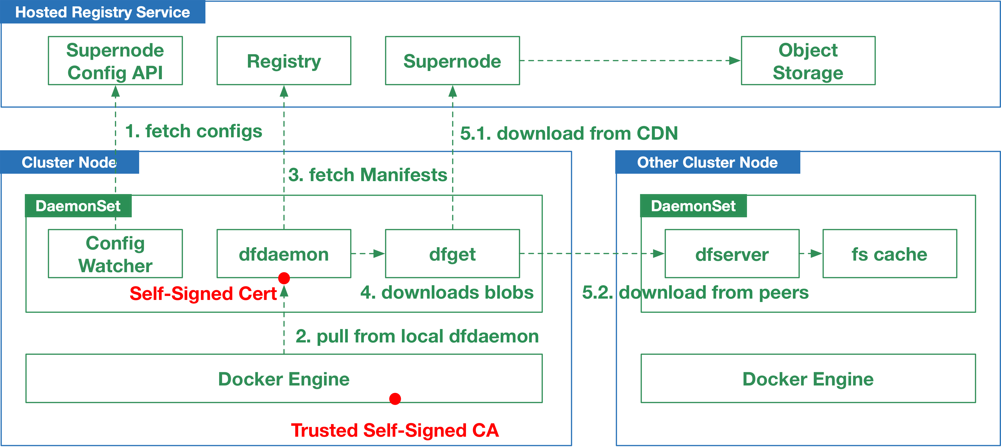
Practice in Alibaba Cloud
ACR(Alibaba Container Registry Service) provides two registry domains, one for normal cases, the other is for P2P distributed pulls, which always points to localhost.
ACR’s P2P image distribution asks users to deploy a DaemonSet in their Kubernetes cluster, and copy a Self-Signed CA to Docker’s configuration path. After this, every node will have a pod running as a registry proxy, then Docker can pull new images using the P2P domain, without any interruption or restart of any containers.

Slide 14
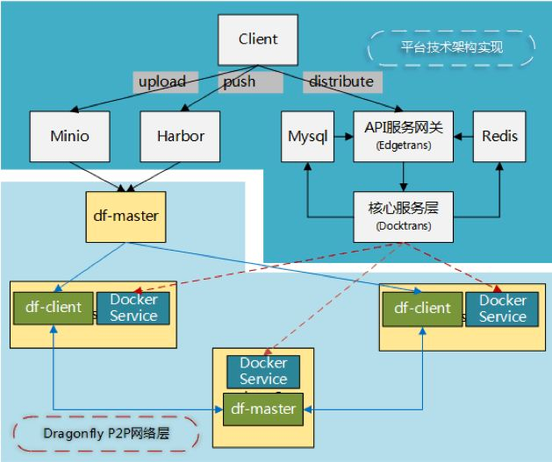
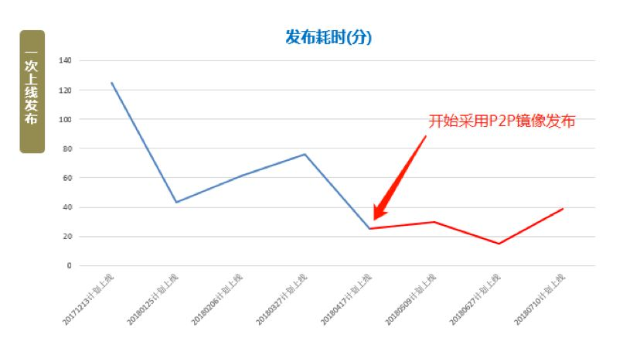

Practice in ZJ Mobile
DCOS ARC
API Gateway
Start to use dragonfly
Kernel service
Dragonfly P2P Overlay

Slide 15
PART FOUR
Roadmap
04

Slide 16
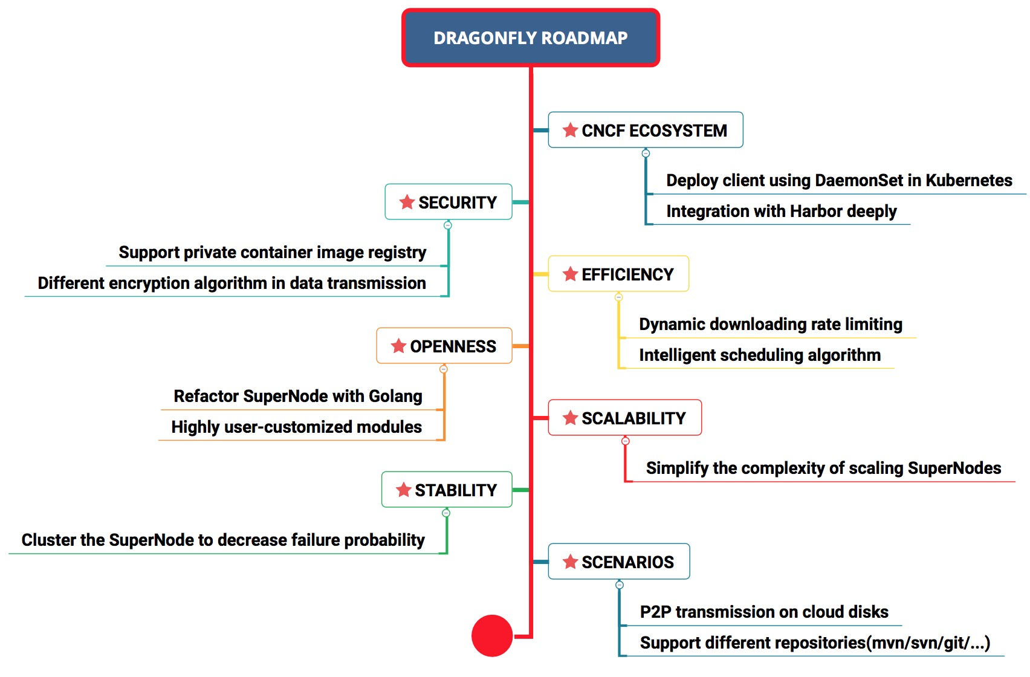
Roadmap

Slide 17
Thanks

